Slide 1



Fast Pedestrian Detection with RGB-Thermal Fusion
A resource-efficient pedestrian detection system, integrating RGB and thermal imagery streams, has been developed. This system was optimized for efficient model development within constrained computational environments, facilitating rapid prototyping and validation.

Slide 2


Project Overview: Resource-Efficient Pedestrian Detection
This project implements an expeditious and resource-optimized pedestrian detection system, meticulously engineered for practical deployment within environments characterized by constrained computational resources.
Expedited Training Regimen
Data Efficiency
Training completion is efficiently achieved on platforms such as Google Colab, typically requiring approximately 2-3 hours utilizing a T4 GPU.
Robust training efficacy is maintained even when utilising a 10% subset of the comprehensive KAIST dataset.
Efficient Inference Architecture
Multimodal Fusion Capability
Inference operations are significantly expedited through the integration of a MobileNetV3 backbone.
The system employs the fusion of RGB and thermal imagery, thereby enhancing the robustness of detection capabilities.

Slide 3





Novel Approach: Optimization for Google Colaboratory Environment
In contrast to conventional research endeavors necessitating high-performance computational resources, this system has been meticulously designed to ensure broad accessibility and computational efficiency within the constraints of Google Colaboratory's free-tier computational environment.
Expedited Training Regimen
Training completion is achieved within an approximate duration of 1.5-2 hours, a significant reduction compared to multi-day processes.
Optimized T4 GPU Deployment
The system effectively utilizes the readily accessible T4 GPU, provided within the free tier, thereby circumventing the necessity for proprietary, high-cost A100 or V100 computational alternatives.
Optimized Memory Footprint
Operation is maintained within a 15GB GPU memory allocation, achieved through the implementation of mixed-precision training techniques.
Streamlined Deployment
The application is executed entirely within a web browser environment, thus requiring no local software installation.

Slide 4

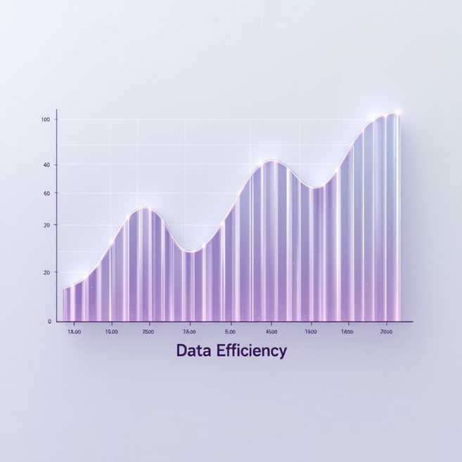
Efficiency Over Accuracy Trade-off
This project explicitly prioritizes practical deployment efficiency, diverging from the conventional academic pursuit of marginal accuracy gains at significant computational cost.
Lightweight Architecture
Minimal Data Philosophy
MobileNetV3-Small (~7.1M parameters) is utilized, in contrast to more computationally intensive models such as ResNet-34 (21M) or ResNet-50 (25M).
Only 10% of the KAIST set00 dataset (17.5K images) is utilized for training, yet it yields meaningful results.
This approach demonstrates robust data efficiency and achieves satisfactory convergence with a restricted sample size.
Inference is achieved at twice the speed of standard approaches.
A straightforward concatenation fusion strategy is employed, obviating the need for intricate attention mechanisms.
Expedited experimentation and iterative development are facilitated, thereby increasing accessibility for students and researchers.

Slide 5




Simplified Fusion and Resource Optimization
It is demonstrated that effective multimodal fusion does not invariably necessitate intricate designs, when coupled with stringent resource management.
Concatenation-Based Fusion
A 1x1 convolution-based fusion layer efficiently integrates RGB and thermal features, thereby circumventing the computational overhead associated with multi-head attention mechanisms. This approach demonstrates that increased architectural complexity does not invariably correlate with enhanced performance.
Resource-Constrained Training
The training regimen has been meticulously optimized for resource-constrained environments through the utilization of 320x240 image resolutions (in contrast to 640x480), a batch size of 16, and the application of mixed-precision training to enhance memory efficiency.
End-to-End Implementation
The implementation is entirely self-contained within a single notebook using pure PyTorch, thereby eliminating reliance on complex framework dependencies (e.g., MMDetection, Detectron2) and fostering pedagogical clarity.

Slide 6

Model Architecture: Dual-Stream MobileNetV3
The architecture efficiently processes both RGB and Thermal inputs through dedicated MobileNetV3 backbones, fusing them for robust pedestrian detection.
Backbone: MobileNetV3-Small (ImageNet pre-trained).
RGB Stream: 3-channel input → 576 feature channels.
Thermal Stream: 1-channel input → 576 feature channels.
Fusion: Concatenation (1152 channels) → 1x1 Conv → 512 channels.
Detection Head: 3-layer CNN → Class scores + Bounding boxes.
Total Parameters: ~7.1M (approximately 2x faster than ResNet-34 based models).
Detection Head
RGB Image
Conv layers for preds
Visible spectrum input
Dual-Stream Fusion Detector
1x1 Conv Fusion
Thermal Image
Channel-wise fusion
Infrared input
Concatenation
MobileNetV3 Backbones
Feature channel merge
Dual MobileNetV3-Small

Slide 7
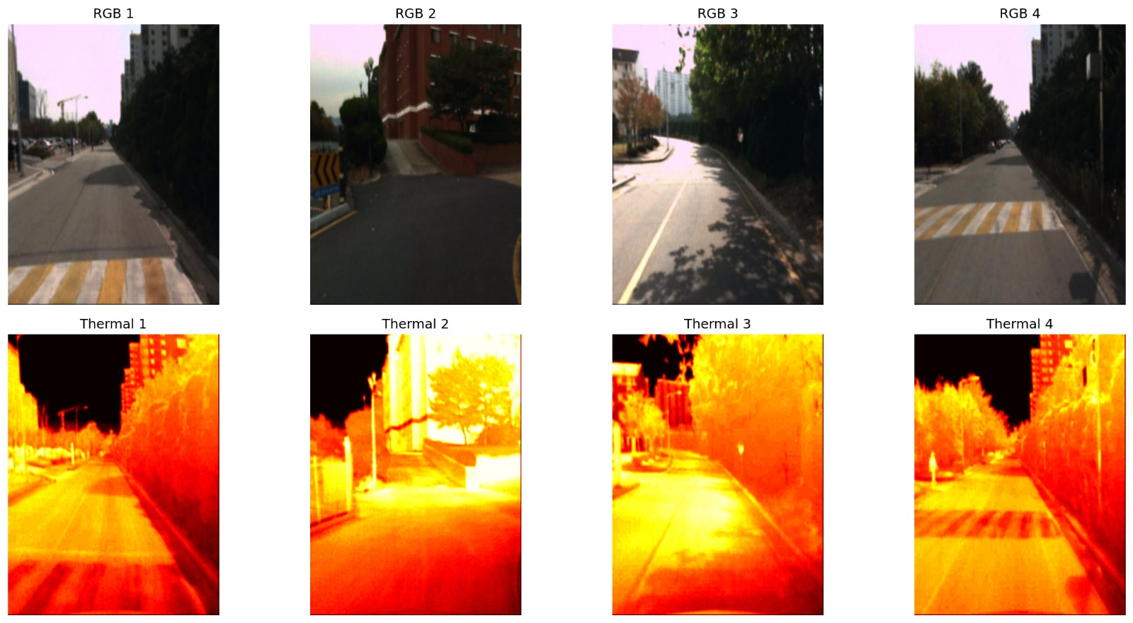
Training Outcomes: Rapid and Efficient Convergence
The model exhibited rapid training and convergence on Google Colab, thereby demonstrating its efficiency and practical utility.
Dataset Statistics (KAIST set00)
Training Configuration
Total Samples: 17,498 RGB-Thermal pairs.
Model Parameters: 7,152,502 total.
Training Set: 12,248 samples (70%).
Epochs: 30.
Validation Set: 2,625 samples (15%).
Batch Size: 16.
Test Set: 2,625 samples (15%).
Optimizer: AdamW (lr=1e-3, weight_decay=1e-4).
Image Dimensions: Standardized to 320×240 pixels from the original 640×480.
Loss Function: MSE loss (output magnitude minimisation).
Mixed Precision: Employed (torch.cuda.amp).
Data Augmentation: Random horizontal flip, colour jitter (applied during training phase only).

Slide 8

Performance Metrics & Model Checkpoint
The system demonstrates robust performance in terms of training time and inference speed, with a pre-trained model available for deployment.
1.5-2h
3.8-3.9
0.0000
Total Training Time
Inference Speed
Final Loss
For 30 epochs on T4 GPU.
Iterations/second on T4 GPU.
Convergence achieved for both training and validation sets.
28.98MB
Model Checkpoint Size
best_model.pth, optimized for inference deployment.
The pre-trained model contains the state dictionary, optimizer state, epoch information, and loss values, thereby facilitating immediate deployment.

Slide 9


Initial Setup and Operation
This section details the expeditious initialization of the system, requiring streamlined dependencies and providing a comprehensive demonstration script.
Installation
Demonstration Script Execution
Installation of requisite packages is achieved via:
The demonstration script can be executed to expeditiously retrieve model-specific information:
pip install -r requirements_lite.txt
python show_model_info.py
PyTorch >= 2.0.0
This script facilitates the retrieval of model file details, architectural specifications, training configuration, and salient features, thereby negating the necessity for dataset acquisition.
torchvision >= 0.15.0
Pillow >= 9.0.0
numpy >= 1.24.0
tqdm >= 4.65.0

Slide 10

Academic Context and Acknowledgements
"This research demonstrates that the successful implementation of a multimodal pedestrian detector can be achieved without requiring substantial computational resources, extensive datasets, or intricate architectural designs. Rather, it underscores the critical role of optimized design principles and judicious engineering decisions within resource-constrained environments."
Author
Anirudh Krishna
1
Institution
University of Maryland, College Park
Program
Master of Science in Applied Machine Learning
2
Course
MSML 640 - Computer Vision (Instructor: Sujeong Kim)
Date
December 2025
3
License
MIT License
We extend our gratitude to the creators of the KAIST Multispectral Pedestrian Dataset, the MobileNetV3 architecture, the PyTorch framework, and Google Colab for their invaluable contributions to this research.

